Slide 1

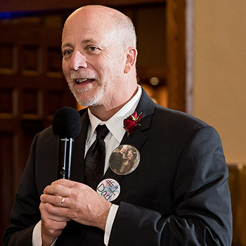

That’s what THEY said….. Hearing it straight from today’s youth
Professor Donald r. Kudek Ph.D.; MBA

Slide 2

Seven Key Lessons
“Good is the enemy of great”
“Confront the brutal facts”
“Get the right people on the bus”
“A culture of discipline”
“The Hedgehog Concept”
“Disciplined thought”
“The flywheel effect.”
“For, in the end, it is impossible to have a great life unless it is a meaningful life. And it is very difficult to have a meaningful life without meaningful work.”

Slide 3

Habit 1: Be Proactive® ...
Habit 2: Begin With the End in Mind® ...
Habit 3: Put First Things First® ...
Habit 4: Think Win-Win® ...
Habit 5: Seek First to Understand, Then to Be Understood® ...
Habit 6: Synergize® ...
Habit 7: Sharpen the Saw®
The key is not to prioritize what's on your schedule, but to schedule your priorities. ...

Slide 4
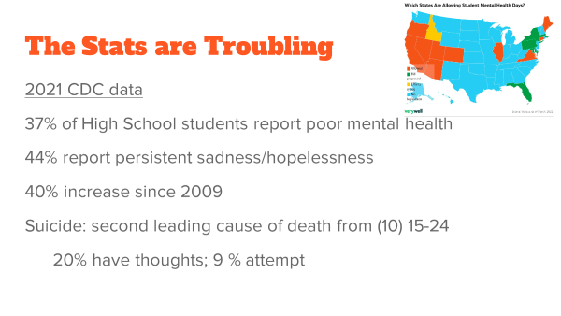

Casey A. Holtz, Ph.D.
Wisconsin Lutheran College
Licensed Psychologist

Slide 5
You Lost Me: Why Young Christians are leaving Church and Rethinking Faith. (Barna 2011)
Eight national studies,
Interviews with teenagers, young adults, parents, youth pastors, and senior pastors,
The study of young adults focused on those who were regular Christian churchgoers during their teen years and explored their reasons for disconnection from church life after age 15.
Notes:
The research project was comprised of eight national studies, including interviews with teenagers, young adults, parents, youth pastors, and senior pastors. The study of young adults focused on those who were regular churchgoers Christian church during their teen years and explored their reasons for disconnection from church life after age 15.
No single reason dominated the break-up between church and young adults. Instead, a variety of reasons emerged. Overall, the research uncovered six significant themes why nearly three out of every five young Christians (59%) disconnect either permanently or for an extended period of time from church life after age 15.

Slide 6
You Lost Me: Why Young Christians are leaving Church and Rethinking Faith. (Barna 2011)
Reason #1 – Churches seem overprotective
Christians demonize everything outside of the church” (approx. 25% of 18-29)
Reason #2 – Teens’/twentysomethings’ experience of Christianity is shallow
Church is boring (31%).
“Faith is not relevant to my career or interests” (24%)
“Bible is not taught clearly or often enough” (23%).
“God seems missing from my experience of church” (20%).
Reason #3 – Churches come across as antagonistic to science.“
Christians are too confident they know all the answers” (35%)
“Churches are out of step with the scientific world we live in” (29%)
“Christianity is anti-science” (25%)
“Been turned off by the creation-versus-evolution debate.” (23%)
Notes:
The research project was comprised of eight national studies, including interviews with teenagers, young adults, parents, youth pastors, and senior pastors. The study of young adults focused on those who were regular churchgoers Christian church during their teen years and explored their reasons for disconnection from church life after age 15.
No single reason dominated the break-up between church and young adults. Instead, a variety of reasons emerged. Overall, the research uncovered six significant themes why nearly three out of every five young Christians (59%) disconnect either permanently or for an extended period of time from church life after age 15.

Slide 7
You Lost Me: Why Young Christians are leaving Church and Rethinking Faith. (Barna 2011)
Reason #4 – Church experiences related to sexuality are simplistic, judgmental
Significant tension sexual purity in this culture and delayed marriages
Young Christians are as sexually active as their non-Christian peers
Young Christians (17%) that made mistakes “feel judged in church because of them”
Reason #5 – They wrestle with the exclusive nature of Christianity
Young adults, shaped by an inclusive culture, look for common ground, even glossing over differences
Young Adults (29%) feel they are “forced to choose between my faith and my friends”
“Church is like a country club, only for insiders” (22%)
Reason #6 – The church feels unfriendly to those who doubt.
Not able “to ask my most pressing life questions in church” (36%)
Having “significant intellectual doubts about my faith” (23%)
Faith “does not help with depression or other emotional problems”(18%)
Notes:
The research project was comprised of eight national studies, including interviews with teenagers, young adults, parents, youth pastors, and senior pastors. The study of young adults focused on those who were regular churchgoers Christian church during their teen years and explored their reasons for disconnection from church life after age 15.
No single reason dominated the break-up between church and young adults. Instead, a variety of reasons emerged. Overall, the research uncovered six significant themes why nearly three out of every five young Christians (59%) disconnect either permanently or for an extended period of time from church life after age 15.

Slide 8

National poll conducted ,February 17–22, 2025,
by Summit Ministries with McLaughlin & Associates found:
55 % of respondents aged 18–29 said that “each person determines their own version of truth” (i.e., they reject the idea of absolute truth).

Slide 9

What are they saying “now”?
Survey Questions: 30
Actual Total Responses: 262 (479 partial)
Age: 18-25
Gender: Both
Household Income: $0 - $200k+
Country: United States
Religion: Christianity

Slide 10
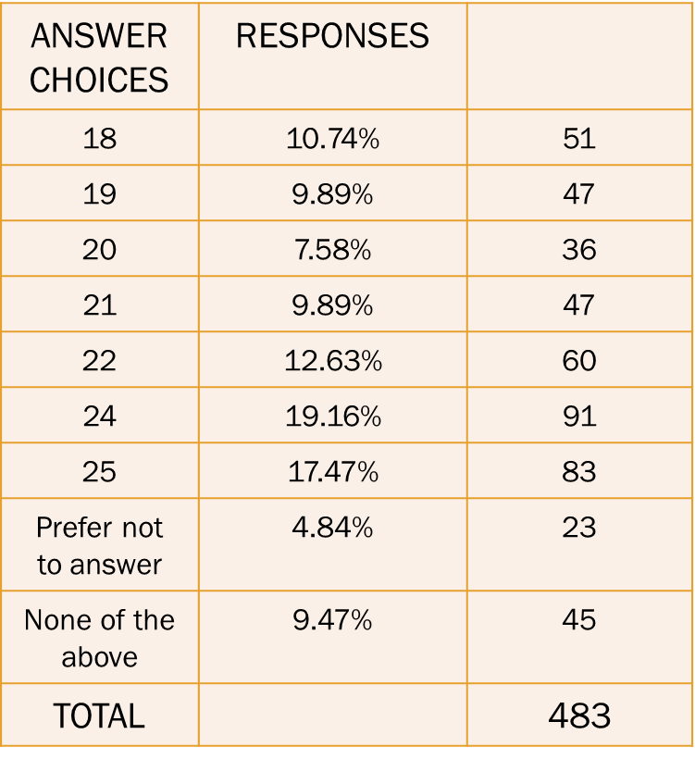
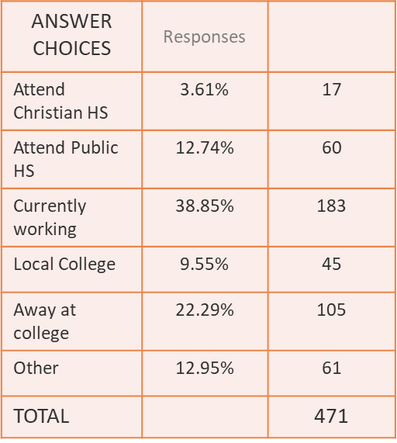
Demographics (Age) (School/Work Status)

Slide 11
Q1: How active are you in your faith through church attendance?
Answered: 479 Skipped: 0

Slide 12
Q2: How active are you in your faith through your church's youth activities?
Answered: 472 Skipped: 7

Slide 13
“Regular" activities in youth group.
 | N.O. - N.I. | N.O. - Int | OFF – N.I. | OFF - ATTEND WHEN CAN | OFF- TRY NEVER TO MISS IT | TOTAL
# 1: Bible study- youth issues | 12.84% 57 | 19.14% 85 | 19.14% 85 | 35.59% 158 | 13.29% 59 | 444
#2 Having food/meal | 7.55% 33 | 19.68% 86 | 19.45% 85 | 36.61% 160 | 16.70% 73 | 437
#3: Game Night - | 10.71% 47 | 21.87% 96 | 21.64% 95 | 30.07% 132 | 15.72% 69 | 439
#4: Activities for friends | 10.88% 48 | 15.87% 70 | 18.37% 81 | 36.05% 159 | 18.82% 83 | 441
#5: Sports tourney | 16.33% 72 | 19.05% 84 | 19.27% 85 | 28.34% 125 | 17.01% 75 | 441
#6: On going sports e.g. fantasy sports | 24.94% 110 | 18.59% 82 | 24.04% 106 | 19.73% 87 | 12.70% 56 | 441
46.8
48.88
53.31
45.79
54.87
45.35
32.43

Slide 14
“Unique" activities in youth group.
 | N.O. - N.I. | N.O. - Int | OFF – N.I. | OFF - ATTEND WHEN CAN | OFF- TRY NEVER TO MISS IT | TOTAL
# 1: Youth led worship night | 15.70 % 70 | 17.26% 77 | 20.85% 93 | 29.15% 130 | 17.04% 76 | 444
#2 Community Service Project | 9.09% 40 | 15.23% 67 | 18.86% 83 | 37.95% 167 | 18.86% 83 | 437
#3: Church Service Project | 13.26% 59 | 17.98% 80 | 18.88% 84 | 32.81% 146 | 15.72% 69 | 439
#4: Outdoor Activities | 14.06% 62 | 22.09% 101 | 16.33% 72 | 30.84% 136 | 15.87% 70 | 441
#5: Youth Prepared dinner | 16.74% 74 | 24.21% 107 | 17.42% 77 | 26.70% 118 | 14.93% 66 | 441
#6: Mission Trip | 14.61% 65 | 19.78% 88 | 24.94% 111 | 24.94% 111 | 15.73% 70 | 441
46.8
46.19
56.81
48.53
46.71
41.63
40.67

Slide 15
“Personal Growth” activities in youth group.
 | N.O. - N.I. | N.O. - Int | OFF – N.I. | OFF - ATTEND WHEN CAN | OFF- TRY NEVER TO MISS IT | TOTAL
# 1: Gift assessment | 11.94 % 53 | 18.92% 84 | 22.30% 99 | 29.28% 130 | 17.57 76 | 444
#2 Personality Assessment | 11.74% 52 | 19.64% 87 | 18.28% 81 | 28.89% 128 | 21.44% 95 | 443
#3: Career Discussions | 12.81% 57 | 19.78% 88 | 17.30% 77 | 32.81% 146 | 17.30% 77 | 445
#4: Personal training – e.g. leadership | 12.11% 54 | 17.49% 78 | 22.20% 99 | 29.37% 131 | 18.83% 84 | 441
#5: Interactive job skill training | 13.74% 61 | 20.50% 91 | 17.79% 79 | 26.70% 118 | 18.83% 84 | 446
48.0
46.85
50.33
50.11
48.20
45.53

Slide 16






That’s what THEY said….. Hearing it straight from today’s youth

Slide 17
Q1: How active are you in your faith through your church's youth activities?
Answered: 322 Skipped: 4
Survey Monkey
ALHS Students

Slide 18
“Regular" activities in youth group.
 | N.O. - N.I. | N.O. - Int | OFF – N.I. | OFF - ATTEND WHEN CAN | OFF- TRY NEVER TO MISS IT | TOTAL
# 1: Bible study- youth issues | 7.10% 12 | 21.89% 37 | 34.32% 58 | 24.26% 41 | 12.43% 21 | 169
#2 Having food/meal | 12.43% 21 | 28.40% 48 | 19.53% 33 | 31.95% 54 | 7.69% 13 | 169
#3: Game Night - | 16.67% 28 | 35.12% 59 | 20.83% 35 | 20.83% 35 | 6.55% 11 | 168
#4: Activities for friends | 13.02% 22 | 26.63% 45 | 24.85% 42 | 24.85% 42 | 10.65% 18 | 169
#5: Sports tourney | 22.49% 38 | 37.28% 63 | 15.98% 27 | 17.16% 29 | 7.10% 12 | 169
#6: On going sports e.g. fantasy sports | 53.89% 90 | 25.75% 43 | 9.58% 106 | 5.99% 10 | 4.79% 8 | 167

Slide 19
“Unique" activities in youth group.
 | N.O. - N.I. | N.O. - Int | OFF – N.I. | OFF - ATTEND WHEN CAN | OFF- TRY NEVER TO MISS IT | TOTAL
# 1: Youth led worship night | 26.63 % 45 | 44.38% 75 | 10.06% 17 | 11.83% 20 | 7.10% 12 | 169
#2 Community Service Project | 20.83% 35 | 37.50% 63 | 17.86% 30 | 18.45% 31 | 5.36% 9 | 168
#3: Church Service Project | 19.76% 33 | 31.74% 53 | 23.95% 40 | 17.96% 30 | 6.59% 11 | 167
#4: Outdoor Activities | 19.64% 33 | 43.45% 73 | 17.86% 30 | 9.52% 16 | 9.52% 16 | 168
#5: Youth Prepared dinner | 31.55% 53 | 34.52% 58 | 8.33% 14 | 15.48% 26 | 10.12% 17 | 168
#6: Mission Trip | 19.64% 33 | 35.12% 59 | 23.21% 39 | 11.90% 20 | 10.12% 17 | 168

Slide 20
“Personal Growth” activities in youth group.
 | N.O. - N.I. | N.O. - Int | OFF – N.I. | OFF - ATTEND WHEN CAN | OFF- TRY NEVER TO MISS IT | TOTAL
# 1: Gift assessment | 14.37 % 24 | 37.13% 62 | 11.38% 19 | 25.15% 42 | 11.98% 20 | 167
#2 Personality Assessment | 22.75% 38 | 44.31% 74 | 10.78% 18 | 14.97% 25 | 7.19% 12 | 167
#3: Career Discussions | 19.76% 33 | 48.50% 81 | 10.78% 18 | 14.37% 24 | 6.59% 11 | 167
#4: Personal training – e.g. leadership | 23.35% 39 | 43.71% 73 | 17.37% 29 | 9.58% 16 | 5.99% 10 | 167
#5: Interactive job skill training | 22.75% 38 | 49.10% 82 | 11.38% 19 | 9.58% 16 | 7.19% 12 | 167

Slide 21
Activities in youth group – ALHS Students
Regular activities Not Offered - Interested | Unique activities Not Offered - Interested | Personal Growth Not Offered - Interested
21.89% (37) | 44.38% (75) | 37.13% (62)
28.40% (48) | 37.50% (63) | 44.31% (74)
35.12% (59) | 31.74% (53) | 48.50% (81)
26.63% (45) | 43.45% (73) | 43.71% (73)
37.28% (63) | 34.52% (58) | 49.10% (82)
25.75% (16) | 35.12% (59)
29.1783% | 37.785% | 44.514%

Slide 22
Q7: My main reason for going is?

Slide 23
Q8: What is/are the reason(s)that you do not attend more events
Answered: 173
53.5%

Slide 24
Q9: Top two regular activities that you would like to see offered.
Answered: 140

Slide 25
Q10: Which are the top two unique programs you would like to see offered.
Answered: 140

Slide 26
Q11: Which are the top two skills programs you would like to see offered.
Answered: 140

Slide 27

That’s what THEY said….. Hearing it straight from today’s youth
Two surveys were sent to Synod Office – one for the youth and one for the youth leader. Those surveys were forwarded to congregational youth contacts and asked to respond and forward the youth survey.

Slide 28
Q1: How active are you in your faith through your church's youth activities?
Answered: 56
Status | Number | Percent
Grade/Middle School | 7 | 12.5%
Christian HS | 27 | 48.2%
Public HS | 7 | 12.5%
Working | 2 | 03.6%
Post HS – Local Classes | 1 | 01.8%
Away at College | 6 | 10.7%
Other | 6 | 10.7%

Slide 29
“Regular" activities in youth group per congregational survey
 | N.O. - N.I. | N.O. - Int | OFF – N.I. | OFF - ATTEND WHEN CAN | OFF- TRY NEVER TO MISS IT | TOTAL
# 1: Bible study- youth issues | 3.12% 1 | 28.12% 9 | 9.38% 3 | 21.88% 7 | 37.50% 12 | 32
#2 Having food/meal | 3.03% 1 | 51.52% 17 | 6.06% 2 | 21.21% 7 | 18.18% 6 | 33
#3: Game Night - | 6.06% 2 | 21.21% 7 | 9.09% 3 | 39.39% 13 | 24.24% 8 | 33
#4: Activities for friends | 9.38% 3 | 25.00% 8 | 12.50% 4 | 31.25% 10 | 21.88% 7 | 32
#5: Sports tourney | 18.18% 6 | 42.42% 14 | 3.03% 1 | 21.21% 7 | 15.15% 5 | 33
#6: On going sports e.g. fantasy sports | 48.48% 16 | 48.48% 16 | 0.00% 0 | 3.03% 1 | 0.00% 0 | 33

Slide 30
“Unique" activities in youth group per congregational survey
 | N.O. - N.I. | N.O. - Int | OFF – N.I. | OFF - ATTEND WHEN CAN | OFF- TRY NEVER TO MISS IT | TOTAL
# 1: Youth led worship night | 39.39 % 13 | 51.52% 17 | 0.00% 0 | 3.03% 1 | 6.06% 2 | 33
#2 Community Service Project | 6.06% 2 | 48.48% 16 | 15.15% 5 | 21.21% 7 | 9.09% 3 | 33
#3: Church Service Project | 9.38% 3 | 43.75% 14 | 3.13% 1 | 31.25% 10 | 12.50% 4 | 32
#4: Outdoor Activities | 9.09% 3 | 69.70% 23 | 0.00% 0 | 12.12% 4 | 9.09% 3 | 33
#5: Youth Prepared dinner | 15.15% 5 | 54.55% 18 | 3.03% 1 | 9.09% 3 | 18.18% 6 | 33
#6: Mission Trip | 15.15% 5 | 60.61% 20 | 6.06% 2 | 3.03% 1 | 15.15% 5 | 33

Slide 31
“Personal Growth" activities in youth group per congregational survey
 | N.O. - N.I. | N.O. - Int | OFF – N.I. | OFF - ATTEND WHEN CAN | OFF- TRY NEVER TO MISS IT | TOTAL
# 1: Gift assessment | 12.12 % 4 | 42.42% 14 | 3.03% 1 | 24.24% 8 | 18.18% 6 | 33
#2 Personality Assessment | 18.18% 6 | 45.45% 15 | 0.00% 0 | 21.21% 7 | 15.15% 5 | 33
#3: Career Discussions | 24.24% 8 | 54.55% 18 | 6.06% 2 | 12.12% 4 | 3.03% 1 | 33
#4: Personal training – e.g. leadership | 33.33% 11 | 48.48% 16 | 6.06% 2 | 9.09% 3 | 3.03% 1 | 33
#5: Interactive job skill training | 24.24% 8 | 60.61% 20 | 0.00% 0 | 9.09% 3 | 6.06% 2 | 33

Slide 32
Activity in youth group – per congregational survey
Regular Activities Not Offered - Interested | Unique activities Not Offered - Interested | Personal Growth Not Offered - Interested
28.13% (09) | 51.52% (17) | 42.42% (14)
51.52% (17) | 48.48% (16) | 45.45% (15)
21.21% (07) | 43.75% (14) | 54.55% (18)
25.00% (08) | 69.70% (23) | 48.48% (16)
42.42% (14) | 54.55% (18) | 60.61% (20)
48.48% (16) | 60.61% (20)
36.12667% | 54.76833% | 50.3020%

Slide 33
Q7: My main reason for going is?

Slide 34
Q8: What is/are the reason(s)that you do not attend more events

Slide 35
Q9: Top two regular activities that you would like to see offered.

Slide 36
Q10: Which are the top two unique programs you would like to see offered.

Slide 37
Q11: Which are the top two skills programs you would like to see offered.

Slide 38
That’s what THEY said….. Hearing it straight from today’s youth
Youth Leadership

Slide 39
Q1: Who is directly driving your youth program?
Answered: 159

Slide 40
“Regular" activities in youth group per youth leader.
 | Not Offered | Not Offered - Wish we could | Offered infrequently – like to do more | Offered frequently – like to do more | Offered frequently –satisfied with offering | TOTAL
# 1: Bible study- youth issues | 8.63% 12 | 15.11% 21 | 20.86% 29 | 20.86% 29 | 34.53% 48 | 139
#2 Having meal w/ activity | 11.59% 16 | 13.04% 18 | 32.61% 45 | 14.49% 20 | 28.26% 39 | 138
#3: Game Night - | 17.86% 25 | 18.57% 26 | 45.00% 63 | 10.00% 14 | 08.57% 12 | 140
#4: Activities for friends | 13.04% 18 | 21.01% 29 | 26.09% 36 | 20.29% 28 | 19.57% 27 | 138
#5: Sports tourney | 29.29% 41 | 31.43% 44 | 28.57% 40 | 05.71% 8 | 05.00% 7 | 140
#6: On going sports | 73.19% 101 | 21.74% 30 | 02.90% 4 | 01.45% 2 | 00.72% 1 | 138
3
36.0 (5)
2
45.7 (4)
1
63.6 (1)
4
47.1 (3)
5
60.0 (2)
6
24.6 (6)

Slide 41
“Unique" activities in youth group per youth leader.
 | Not Offered | Not Offered - Wish we could | Offered infrequently – like to do more | Offered frequently – like to do more | Offered frequently –satisfied with offering | TOTAL
# 1: Youth led worship night | 57.45 % 81 | 31.91% 45 | 08.51% 12 | 01.42% 1 | 00.71% 1 | 141
#2 Community Service Project | 18.44% 26 | 37.59% 53 | 35.46% 50 | 02.13% 3 | 06.38% 9 | 141
#3: Church Service Project | 14.29% 20 | 26.43% 37 | 38.57% 54 | 10.71% 15 | 10.00% 14 | 140
#4: Outdoor Activities | 20.71% 29 | 36.43% 51 | 32.14% 45 | 05.71% 8 | 05.00% 7 | 140
#5: Youth Prepared dinner | 37.14% 52 | 37.86% 53 | 19.29% 27 | 02.86% 4 | 02.86% 4 | 140
#6: Mission Trip | 33.33% 46 | 44.20% 61 | 13.77% 19 | 02.90% 4 | 05.80% 8 | 140
40.4 (6)
4
73.1 (1)
5
65.0 (3)
5
68.6 (2)
1
57.2 (5)
3
2
58.0 (4)

Slide 42
“Personal Growth” activities in youth group per youth leader.
 | Not Offered | Not Offered - Wish we could | Offered infrequently – like to do more | Offered frequently – like to do more | Offered frequently –satisfied with offering | TOTAL
# 1: Gift assessment | 38.13% 53 | 43.88% 61 | 12.23% 17 | 03.60% 5 | 02.16% 3 | 139
#2 Personality Assessment | 43.17% 60 | 43.17% 60 | 10.07% 14 | 02.16% 3 | 01.44% 2 | 139
#3: Career Discussions | 40.29% 56 | 43.88% 61 | 09.35% 13 | 03.60% 5 | 02.88% 4 | 139
#4: Personal training – e.g. leadership | 32.37% 45 | 53.96% 75 | 09.35% 13 | 02.88% 4 | 01.44% 2 | 139
#5: Interactive job skill training | 31.16% 43 | 52.90% 73 | 11.59% 16 | 02.90% 16 | 01.45% 2 | 138
56.1 (3)
5
53.2 (4)
2
53.2 (4)
2
63.3 (2)
4
64.5 (1)
1

Slide 43
Q9: Top three regular activities that would have biggest impact on church youth.
Answered: 88
Score indicates the percentage of respondents that had this item in top three

Slide 44
Q10: Which are the top two unique programs you would like to see offered.
Answered: 140
Score indicates the percentage of respondents that had this item in top three

Slide 45
Q11: Which are the top two skills programs you would like to see offered.
Answered: 140
Score indicates the percentage of respondents that had this item in top three

Slide 46
Activities of interest by church youth
Regular Activities Not Offered - Interested | Unique activities Not Offered - Interested | Personal Growth Not Offered - Interested
28.13% (09) | 51.52% (17) | 42.42% (14)
51.52% (17) | 48.48% (16) | 45.45% (15)
21.21% (07) | 43.75% (14) | 54.55% (18)
25.00% (08) | 69.70% (23) | 48.48% (16)
42.42% (14) | 54.55% (18) | 60.61% (20)
48.48% (16) | 60.61% (20)
36.12667% | 54.76833% | 50.3020%

Slide 47
Activities of interest by ALHS youth
N.O. - Int | Unique activities Not Offered - Interested | Personal Growth Not Offered - Interested
21.89% (37) | 44.38% (75) | 37.13% (62)
28.40% (48) | 37.50% (63) | 44.31% (74)
35.12% (59) | 31.74% (53) | 48.50% (81)
26.63% (45) | 43.45% (73) | 43.71% (73)
37.28% (63) | 34.52% (58) | 49.10% (82)
25.75% (16) | 35.12% (59)
29.1783% | 37.785% | 44.514%

Slide 48
Ways to grow a program?

Slide 49
Existing Offerings
New Offerings
Offering Development
Existing Attendee Base
Penetration
More Risk
Attendee Development
Re - Development
New Attendee Base
More Risk

Slide 50
Ideas for Consideration
Integrated Christian Community: A vision for Spiritual Formation for all ages (Pyles, 2024, Dis)
Intentional Intergenerational activities which led to increased sense of belonging
The Church of Tomorrow Starts Today (Power, C., 2024 Dis)
Young people feel connected due to older membership relationship
Young people feel connected to the worship experience
Deep connection due to to study of the Word of God
Appreciate how leaders handle social and political issues

Slide 51
Ideas for Consideration (cont.)
Bridging the Gap – effective strategies to engage emerging adults in the church (Bulger, 2024, Dis)
Change, support, being heard, valued, teaching/training, and inclusion are needed
Preparing the Next Generation for Faith Ownership by Training Fathers in the Biblical Worldview (Embrey, J., nd, dis)
Seven Week training program for fathers in biblical worldview and mentoring skills

Slide 52




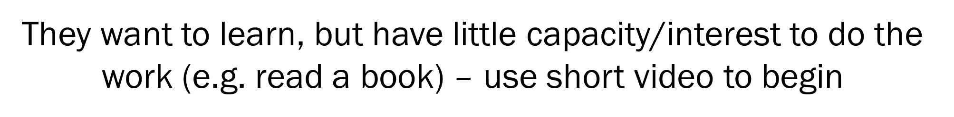


Students are looking for deep connection – small group studies

Slide 53

In The Steps of Peter – The H.U.M.B.L.E. Follower
Gift Assessment
Evaluating the roles of H.U.M.B.L.E. Followers
Honest
Unwavering
Mission Minded
Bold
Learned
Emotional Intelligent
Personal Mission Statement
Development Plan

Slide 54

Love to hear your thoughts……
donald.kudek@wlc.edu

